Slide 1
SAP BTP Extension Suite Training
Day 5
Anubhav Oberoy
www.AnubhavTrainings.com
Follow excellence with sheer passion

Slide 2


DISCLAIMER
The training content and delivery of this presentation is confidential, and cannot be recorded, or copied and distributed to any third party, without the written consent of Anubhav Trainings

Slide 3
Agenda – Day 5
01
04
Introduction to HANA Cloud
Generic Handlers
02
05
Fiori Elements
Working with containers
03
06
Annotations for Fiori Application
Deploy App to CF

Slide 4
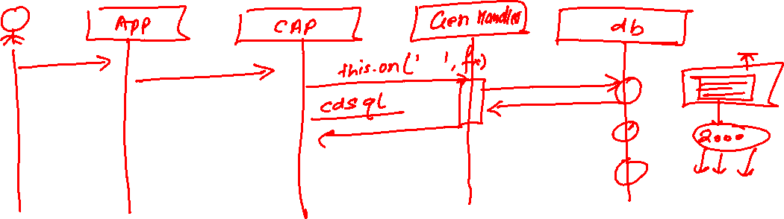
Exercise – generic handlers
Exercise:
https://github.com/soyuztechnologies/SAP_BTP_Training_CLD200/blob/master/Day%203/02srv/MyService.cds
https://github.com/soyuztechnologies/SAP_BTP_Training_CLD200/blob/master/Day%203/02srv/MyService.js

Slide 5


















Slide 6
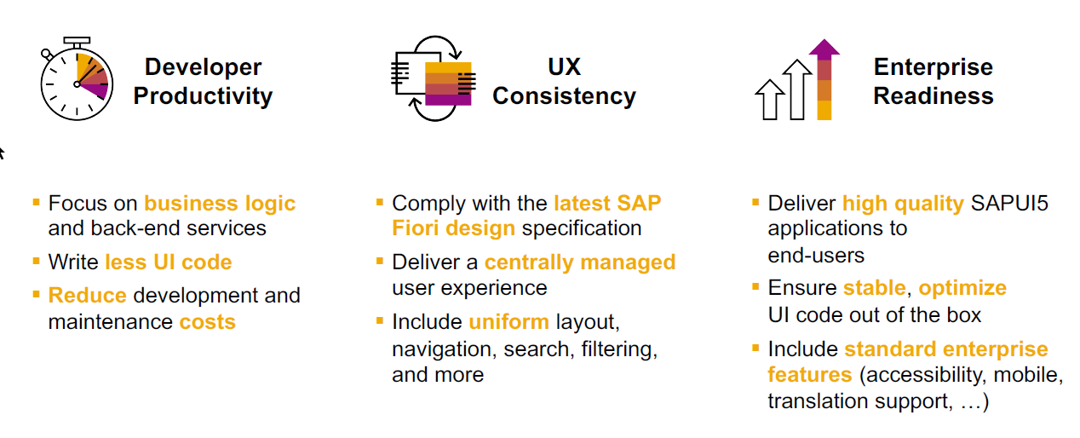
SAP Fiori elements boosts SAP Fiori development efficiency

Slide 7
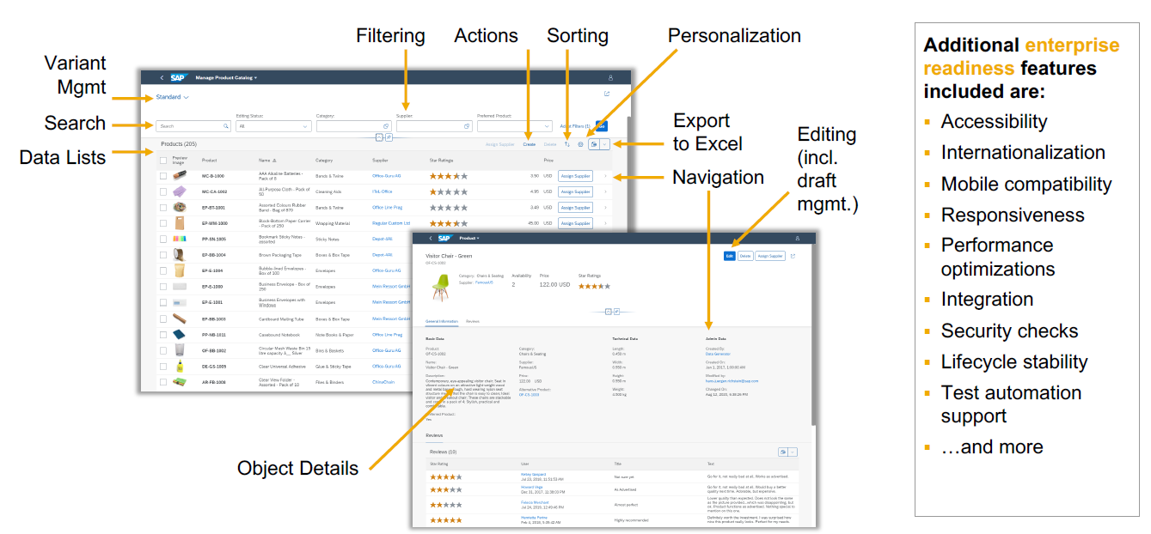
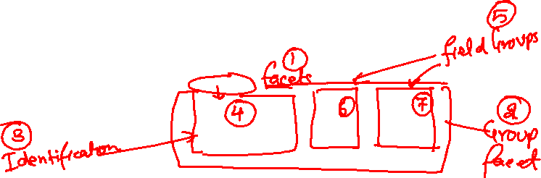
SAP Fiori elements provides enterprise-ready apps out of the box

Slide 8
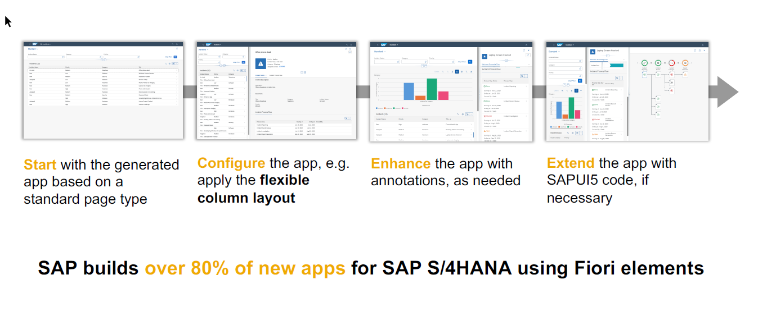
SAP Fiori elements application architecture provides flexibility

Slide 9
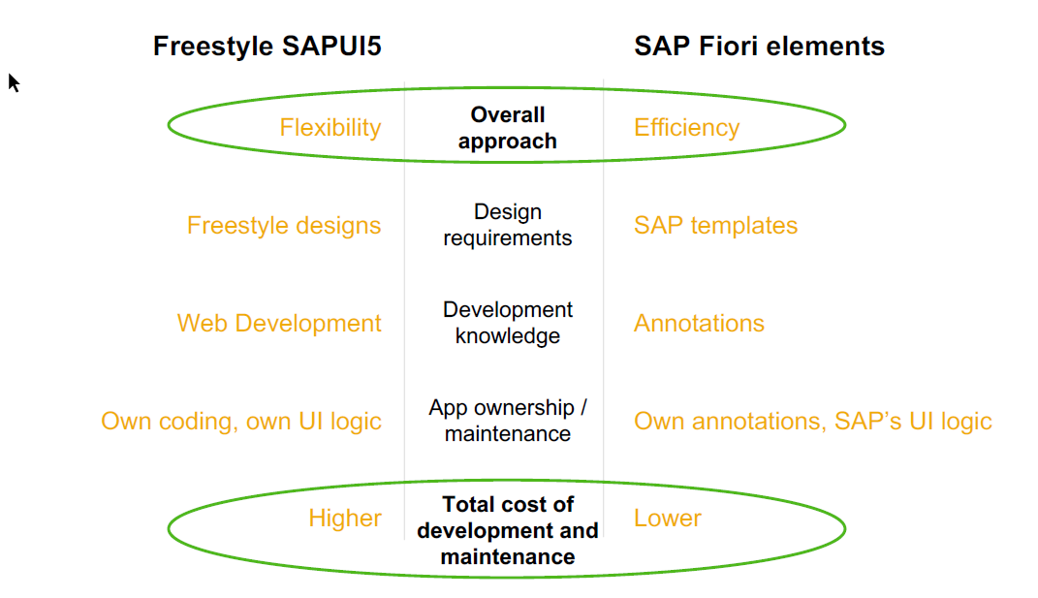
SAP Fiori elements prioritizes efficiency over flexibility

Slide 10

Hands on : Fiori App

Slide 11
Create Fiori App using Annotation
Exercise:
https://github.com/soyuztechnologies/SAP_BTP_Training_CLD200/blob/master/Day%203/03%20application/03application/app/purchaseorderapp/annotations.cds

Slide 12





























Slide 13
Association v.s Composition
Association – a relationship between entities which is a lose coupling. Both objects should exist together. However, they can work independently. Airplane and passenger.
Composition – a relationship between entities which is a tight coupling. Both objects must exist together. They cannot function independently. Airplane and wings.
Purchase Order Header
composition
Purchase order Items

Slide 14


































Slide 15

Hands on: Create & F4 Enablement for app
Solution: https://github.com/soyuztechnologies/SAP_BTP_Training_CLD200/tree/master/Day%204/capm%20draft%20and%20value%20helps

Slide 17

What We Did
Let’s Summarize

Slide 18

www.anubhavtrainings.com
Thank You
End of Day 5

Slide 19


We’re committed to empower you to be
#FutureReady
through powerful training solutions.
We build the workforce of the future.
250+
Corporate Clients
50,000+
Learners Trained
25000+
Learners Placed
FREE WEBINARS
Sign up for free webinars with industry experts every fortnight!
Enroll Now!
Contact us today!
https://anubhavtrainings.com

Slide 20
Agenda – Day 5
01
04
Application Security
Identity Provider
02
05
MTA applications with module
Roles and Authorization management
03
06
CAP Application Security Testing
XSUAA Service

